Slide 1

Poisson Distribution
This is a discrete type distribution that is used to model the frequency of a specific event occurring in a particular period of time or in some specified region.
Time interval → a second, a minute, a day, or a month etc.
Specific region → particular area, volume, or a piece of paper etc.
The Poisson distribution formula is:
X → the number of times the event occur
λ → parameter, the mean of X.
Its mean = variance
Notes:
This distribution is also called the law of small number or the rare events distribution.

Slide 2
Examples where Poisson Distribution may apply
The number of phone calls received in a call center per hour.
The number of typological errors per page in an article.
The number of white cells in a blood sample of a dengue patient.
The number of bus arrivals at an intersection per hour or per day.
The number of accidents at an intersection per month.
The number of corona virus patients arrive per day in a quarantine of a hospital.

Slide 3
Example # 01: Radioactive Particles
During an experiment in a nuclear laboratory, the mean number of radioactive particles passing through a beam in 1 microsecond is 3. Find the probability that 6 particles passing through the beam in a given microsecond?
Notes:
P(X=6) = 0.0504

Slide 4
Example # 02: Oil Tankers arrival
The average number of oil tankers arrive in a refinery is 10 per day. The maximum limit of arrival in a refinery is 15 tankers per day. Find out the probability that on a given day more than 15 tankers arrive in an oil refinery.
Notes:
P(X>15) = 1 – P(X<=15) = 1 – 0.9513 = 0.0487.

Slide 5
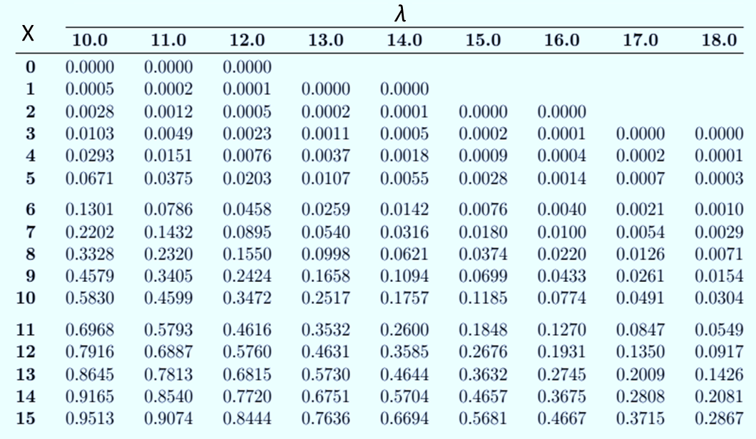
Snapshot of a Poisson Probability Sums Table

Slide 6
Example # 03: Typing mistakes
A data entry specialist identified 200 typing mistakes in a report that contain 500 pages. Find the probability of committing exactly three 3 mistakes in a particular page.
Notes:
Mean = 200/500 = 0.4 & P(X=3, mean = 0.4) = 0.0072

Slide 7
Example # 20: Toll – Free Telephone Calls
A sales firm receives, on average, 3 calls per hour on its toll-free number. For any given hour, find the probability that it will receive the following.
(a) At most 3 calls
(b) At least 3 calls
(c) 5 or more calls
Notes:
P(x<=3)= 0.6472
(b) P(X >=3) = 0.5768
(c) P(X>=5) = 0.1848

Slide 8
Example # 21: Left-Handed People
The Poisson distribution can also be used to approximate the binomial distribution when the expected value λ = np is less than 5 as shown in the example below:
Approximately 2% of the people in a room of 200 people are left-handed, find the probability that exactly 5 people are left-handed.
Notes:
Mean of binomial = np = (200)*(0.02) = 4 & P(X=5) = 0.1563

